Slide 1
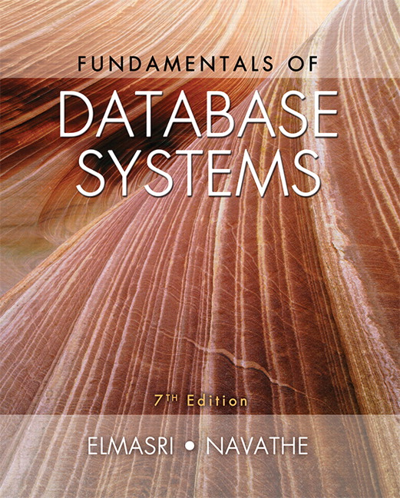

Slide 2
CHAPTER 6
Basic SQL

Slide 3
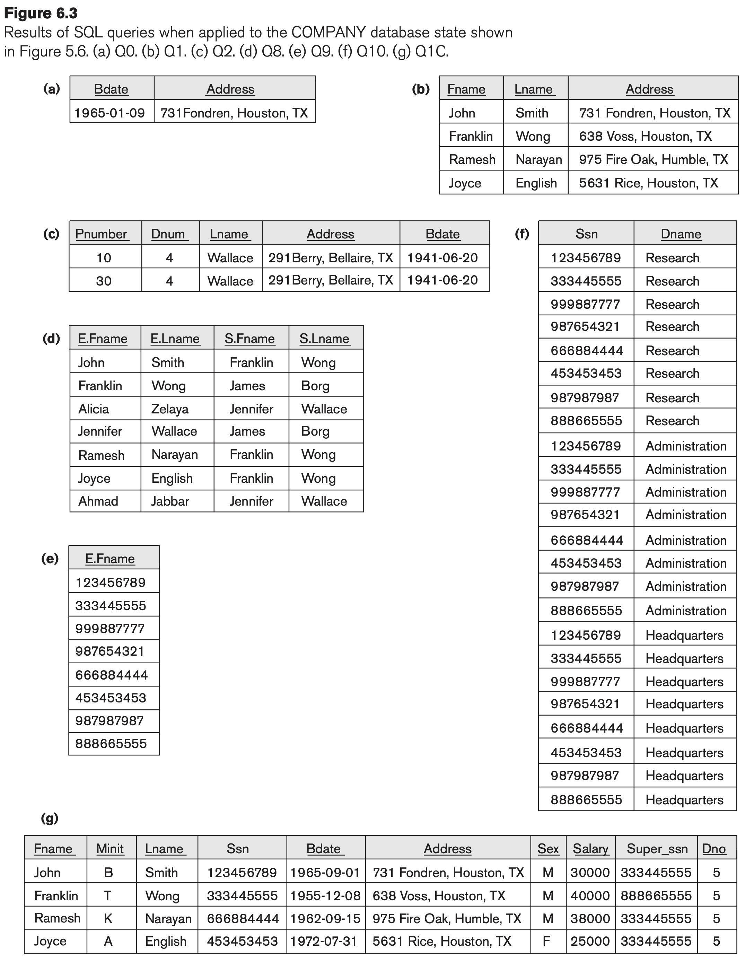

Slide 4
Chapter 6 Outline
SQL Data Definition and Data Types
Specifying Constraints in SQL
Basic Retrieval Queries in SQL
INSERT, DELETE, and UPDATE Statements in SQL
Additional Features of SQL

Slide 5
Basic SQL
SQL language
Considered one of the major reasons for the commercial success of relational databases
SQL
SQL was proposed initially as the language SQUARE.
SQL Actually comes from the word “SEQUEL” which was the original term used in the paper: “SEQUEL TO SQUARE” by Chamberlin and Boyce. IBM could not copyright that term, so they abbreviated to SQL and copyrighted the term SQL.
Now popularly known as “Structured Query language”.
SQL is an informal or practical rendering of the relational data model with syntax

Slide 6
Basic SQL
The relational algebra operations are too low-level for most commercial DBMS users
The user must specify how—that is, in what order—to execute the query operations
Although SQL includes some features from relational algebra, it is based to a greater extent on the tuple relational calculus,
SQL is a higher-level declarative language

Slide 7
SQL Data Definition, Data Types, Standards
Terminology:
Table, row, and column used for relational model terms relation, tuple, and attribute
CREATE statement
Main SQL command for data definition
The language has features for : Data definition, Data Manipulation, Transaction control (Transact-SQL, Ch. 20), Indexing (Ch.17), Security specification (Grant and Revoke- see Ch.30), Active databases (Ch.26), Multi-media (Ch.26), Distributed databases (Ch.23) etc.

Slide 8
SQL Standards
SQL has gone through many standards: starting with SQL-86 or SQL 1.A. SQL-92 is referred to as SQL-2.
Later standards (from SQL-1999) are divided into core specification and specialized extensions. The extensions are implemented for different applications – such as data mining, data warehousing, multimedia etc.
SQL-2006 added XML features (Ch. 13); In 2008 they added Object-oriented features (Ch. 12).
SQL-3 is the current standard which started with SQL-1999. It is not fully implemented in any RDBMS.

Slide 9
Schema and Catalog Concepts in SQL
We cover the basic standard SQL syntax – there are variations in existing RDBMS systems
SQL schema
Identified by a schema name
Includes an authorization identifier and descriptors for each element
Schema elements include
Tables, constraints, views, domains, and other constructs
Each statement in SQL ends with a semicolon

Slide 10
Schema and Catalog Concepts in SQL (cont’d.)
CREATE SCHEMA statement
CREATE SCHEMA COMPANY AUTHORIZATION ‘Jsmith’;
Catalog
Named collection of schemas in an SQL environment
SQL also has the concept of a cluster of catalogs.
a named collection of schemas

Slide 11
The CREATE TABLE Command in SQL
Specifying a new relation
Provide name of table
Specify attributes, their types and initial constraints
Can optionally specify schema:
CREATE TABLE COMPANY.EMPLOYEE ...
or
CREATE TABLE EMPLOYEE ...

Slide 12
The CREATE TABLE Command in SQL (cont’d.)
Base tables (base relations)
Relation and its tuples are actually created and stored as a file by the DBMS
Virtual relations (views)
Created through the CREATE VIEW statement. Do not correspond to any physical file.

Slide 13
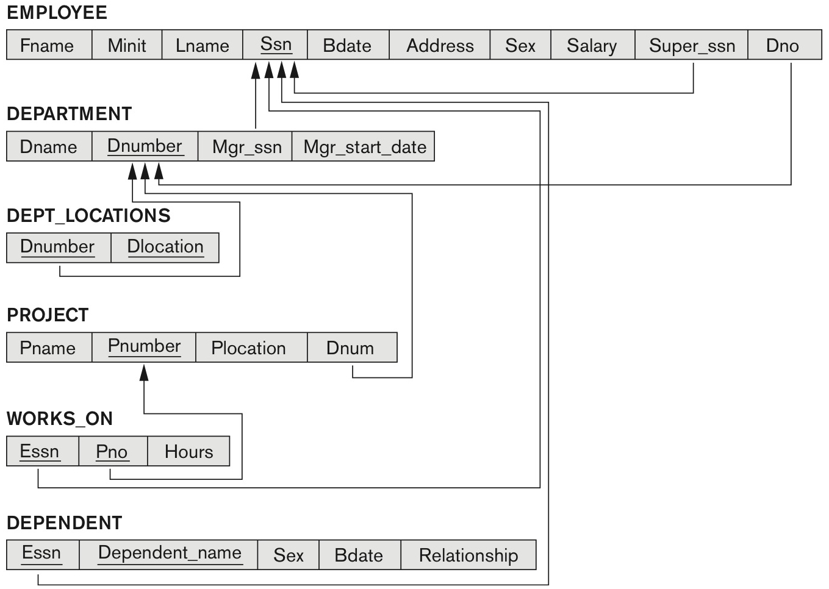
COMPANY relational database schema (Fig. 5.7)

Slide 14
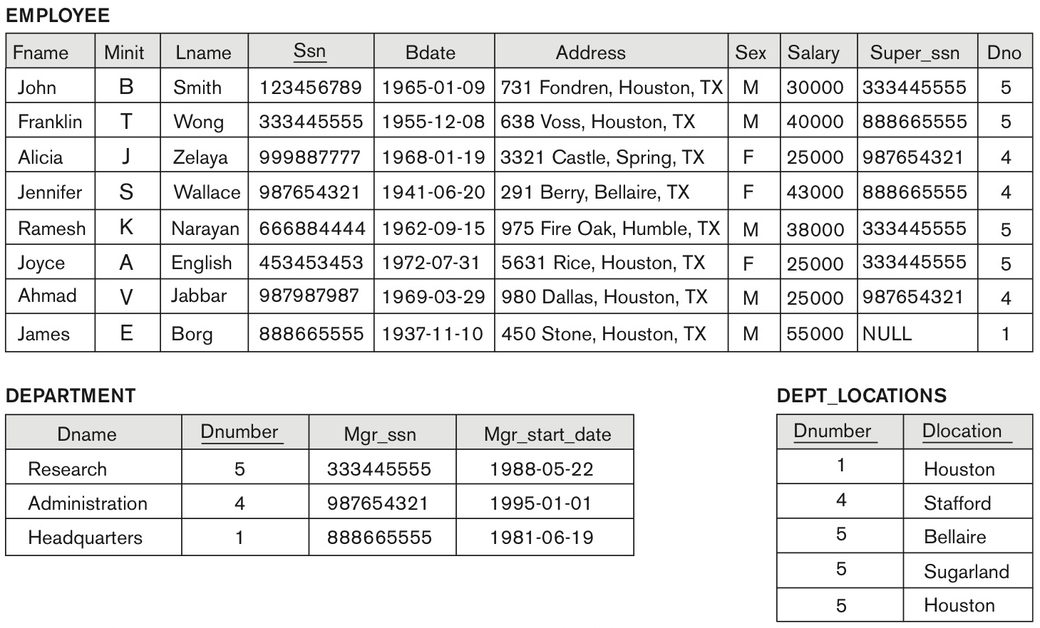
One possible database state for the COMPANY relational database schema (Fig. 5.6)

Slide 15
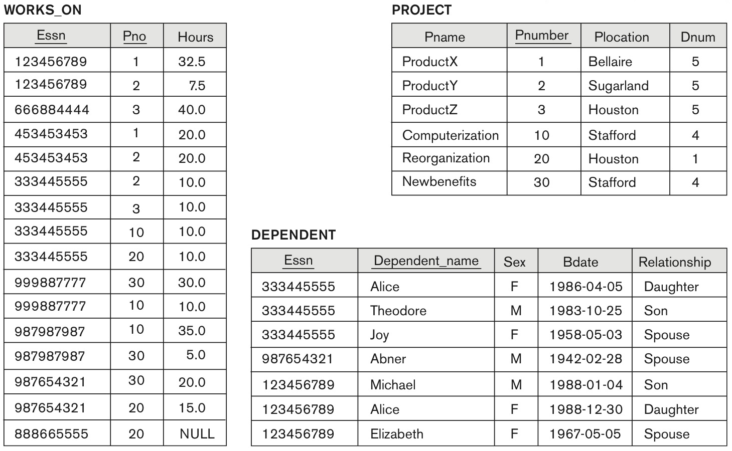
One possible database state for the COMPANY relational database schema – continued (Fig. 5.6)

Slide 16
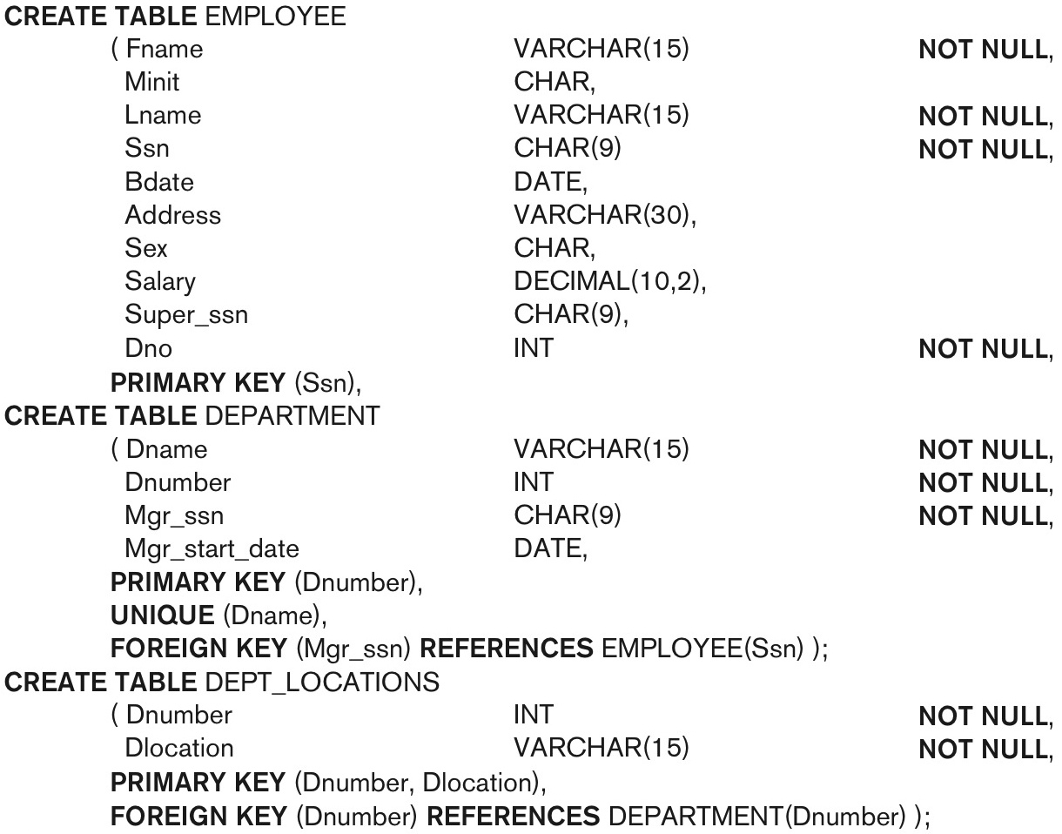
SQL CREATE TABLE data definition statements for defining the COMPANY schema from Figure 5.7 (Fig. 6.1)
continued on next slide

Slide 17
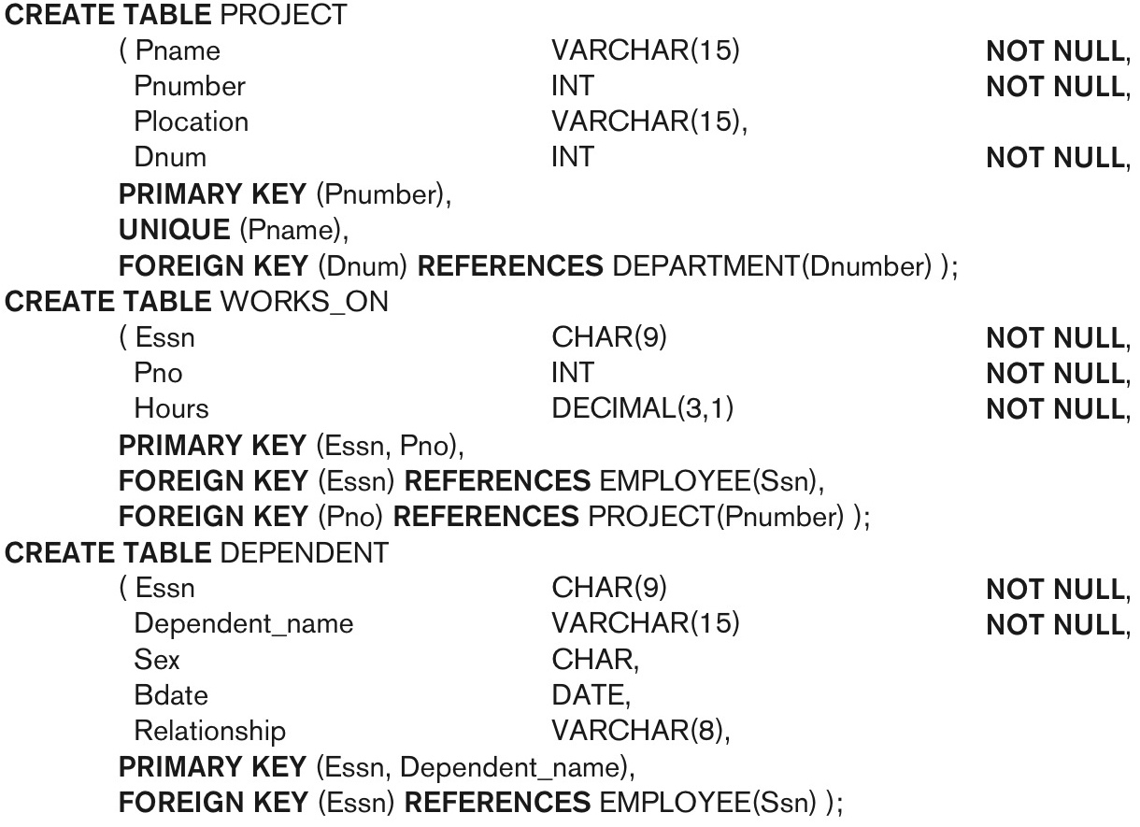
SQL CREATE TABLE data definition statements for defining the COMPANY schema from Figure 5.7 (Fig. 6.1)-continued

Slide 18
The CREATE TABLE Command in SQL (cont’d.)
Rows are not ordered
Some foreign keys may cause errors
Specified either via:
Circular references (Ex: EMPLOYEE superSSN)
Or because they refer to a table that has not yet been created
DBA’s have ways to stop referential integrity enforcement to get around this problem.

Slide 19
The Alter Table Command
The ALTER TABLE command in SQL is used to modify an existing table. It allows you to add, delete, or modify columns, as well as add constraints or rename the table.
Add a Column
ALTER TABLE table_name
ADD column_name datatype;
Drop a Column
ALTER TABLE table_name
DROP COLUMN column_name;

Slide 20
The Alter Table Command
Add a New Column
ALTER TABLE employees
ADD age INT;
Delete a Column
ALTER TABLE employees
DROP COLUMN age;
Modify a Column’s Data Type
ALTER TABLE employees
MODIFY COLUMN age BIGINT;

Slide 21
The Alter Table Command
CREATE TABLE departments (
department_id INT PRIMARY KEY,
department_name VARCHAR(100) NOT NULL);
CREATE TABLE employees (
employee_id INT PRIMARY KEY,
employee_name VARCHAR(100) NOT NULL,
department_id INT -- This will be our foreign key);
ALTER TABLE employees
ADD CONSTRAINT fk_department
FOREIGN KEY (department_id)
REFERENCES departments(department_id)
ON DELETE CASCADE;

Slide 22
The Alter Table Command
Add a Constraint (e.g., NOT NULL, UNIQUE, CHECK, FOREIGN KEY)
ALTER TABLE employees
ADD CONSTRAINT unique_email UNIQUE (email);
Drop a Constraint
ALTER TABLE employees
DROP CONSTRAINT unique_email;

Slide 23
Drop Table
The DROP TABLE command in SQL is used to delete an existing table from the database. When you execute this command, the table and all of its data, structure, and constraints (like primary keys or foreign keys) are permanently removed. Use this command with caution, as it cannot be undone!
DROP TABLE table_name;
E.g., DROP TABLE employees;

Slide 24
Attribute Data Types and Domains in SQL
Basic data types
Numeric data types
Integer numbers: INTEGER, INT, and SMALLINT
Floating-point (real) numbers: FLOAT or REAL, and DOUBLE PRECISION
Character-string data types
Fixed length: CHAR(n), CHARACTER(n)
Varying length: VARCHAR(n), CHAR VARYING(n), CHARACTER VARYING(n)
Another variable-length string data type called CHARACTER LARGE OBJECT or CLOB is also available to specify columns that have large text values, such as documents.

Slide 25
Attribute Data Types and Domains in SQL (cont’d.)
Bit-string data types
Fixed length: BIT(n)
Varying length: BIT VARYING(n)
Boolean data type
Values of TRUE or FALSE or NULL
DATE data type
Ten positions
Components are YEAR, MONTH, and DAY in the form YYYY-MM-DD
Multiple mapping functions available in RDBMSs to change date formats

Slide 26
Attribute Data Types and Domains in SQL (cont’d.)
Additional data types
Timestamp data type
Includes the DATE and TIME fields
Plus a minimum of six positions for decimal fractions of seconds e.g., TIMESTAMP ‘2014-09-27 09:12:47.648302’
Optional WITH TIME ZONE qualifier e.g., -05:00
INTERVAL data type e.g., SELECT CURRENT_DATE + INTERVAL '5 DAYS’;
Specifies a relative value that can be used to increment or decrement an absolute value of a date, time, or timestamp
DATE, TIME, Timestamp, INTERVAL data types can be cast or converted to string formats for comparison.

Slide 27
Attribute Data Types and Domains in SQL (cont’d.)
Domain
Name used with the attribute specification
Makes it easier to change the data type for a domain that is used by numerous attributes
Improves schema readability
Example:
CREATE DOMAIN SSN_TYPE AS CHAR(9);
TYPE
User Defined Types (UDTs) are supported for object-oriented applications. (See Ch.12) Uses the command: CREATE TYPE

Slide 28
Specifying Constraints in SQL
Basic constraints:
Relational Model has 3 basic constraint types that are supported in SQL:
Key constraint: A primary key value cannot be duplicated
Entity Integrity Constraint: A primary key value cannot be null
Referential integrity constraints : The “foreign key “ must have a value that is already present as a primary key, or may be null.

Slide 29
Specifying Attribute Constraints
Other Restrictions on attribute domains:
Default value of an attribute
DEFAULT <value> e.g.,age INT DEFAULT 25
Because SQL allows NULLs as attribute values, a constraint NOT NULL may be specified if NULL is not permitted for a particular attribute.
CHECK clause
Dnumber INT NOT NULL CHECK (Dnumber > 0 AND Dnumber < 21);
CREATE DOMAIN D_NUM AS INTEGER
CHECK (D_NUM > 0 AND D_NUM < 21);

Slide 30
Specifying Key and Referential Integrity Constraints
PRIMARY KEY clause
Specifies one or more attributes that make up the primary key of a relation
Dnumber INT PRIMARY KEY;
UNIQUE clause
Specifies alternate (secondary) keys (called CANDIDATE keys in the relational model).
Dname VARCHAR(15) UNIQUE;

Slide 31
Specifying Key and Referential Integrity Constraints (cont’d.)
FOREIGN KEY clause
Default operation: reject update on violation
Attach referential triggered action clause
Options include SET NULL, CASCADE, and SET DEFAULT
Action taken by the DBMS for SET NULL or SET DEFAULT is the same for both ON DELETE and ON UPDATE
CASCADE option suitable for “relationship” relations

Slide 32
Giving Names to Constraints
Using the Keyword CONSTRAINT
Name a constraint
Useful for later altering
CREATE TABLE employees (
emp_id INT NOT NULL,
name VARCHAR(50),
age INT,
CONSTRAINT pk_employees PRIMARY KEY (emp_id)
);

Slide 33
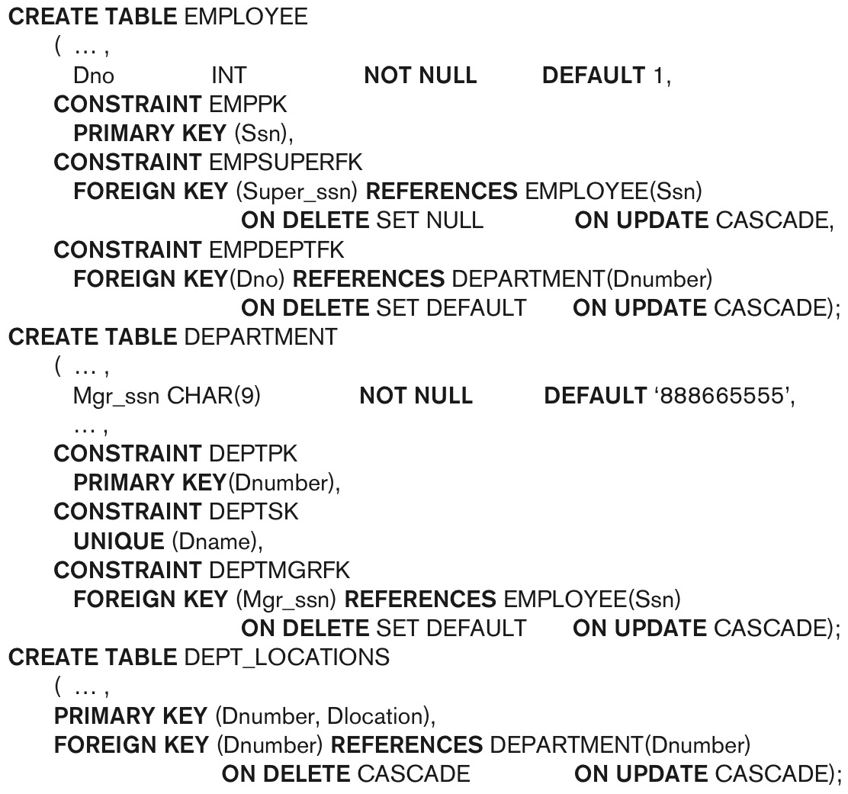
Default attribute values and referential integrity triggered action specification (Fig. 6.2)

Slide 34
Specifying Constraints on Tuples Using CHECK
Additional Constraints on individual tuples within a relation are also possible using CHECK
CHECK clauses at the end of a CREATE TABLE statement
Apply to each tuple individually
CHECK (Dept_create_date <= Mgr_start_date);

Slide 35
Basic Retrieval Queries in SQL
SELECT statement
One basic statement for retrieving information from a database
SQL allows a table to have two or more tuples that are identical in all their attribute values
Unlike relational model (relational model is strictly set-theory based)
Multiset or bag behavior
Tuple-id may be used as a key

Slide 36
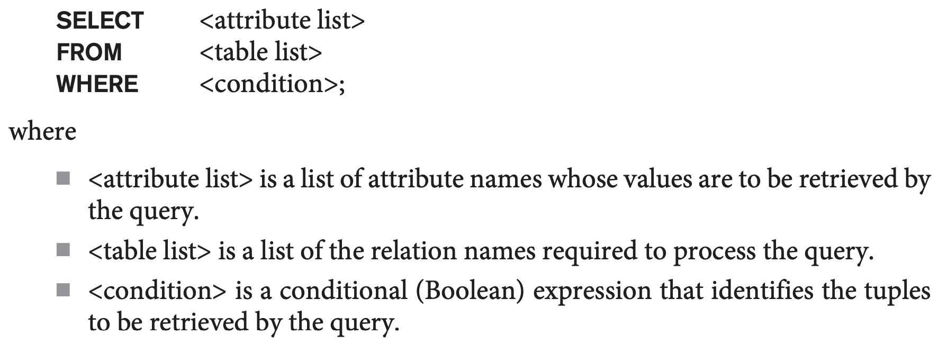
The SELECT-FROM-WHERE Structure of Basic SQL Queries
Basic form of the SELECT statement:

Slide 37
The SELECT-FROM-WHERE Structure of Basic SQL Queries (cont’d.)
Logical comparison operators
=, <, <=, >, >=, and <>
Projection attributes
Attributes whose values are to be retrieved
Selection condition
Boolean condition that must be true for any retrieved tuple. Selection conditions include join conditions (see Ch.8) when multiple relations are involved.

Slide 38
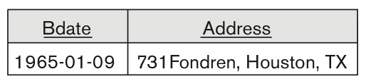
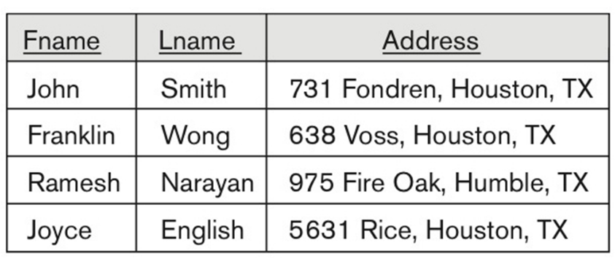
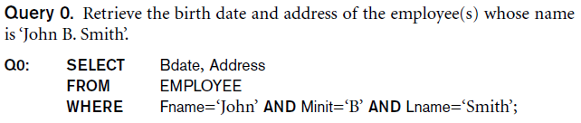
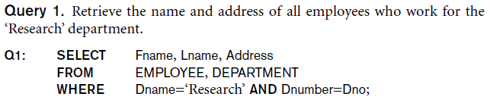
Basic Retrieval Queries

Slide 39
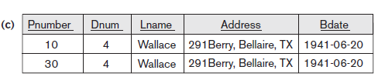
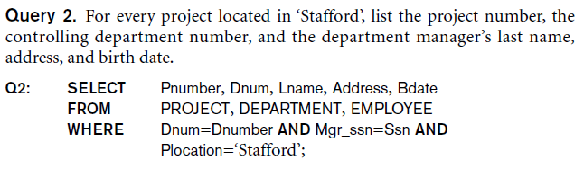
Basic Retrieval Queries (Contd.)

Slide 40
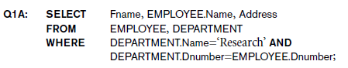
Ambiguous Attribute Names
Same name can be used for two (or more) attributes in different relations
As long as the attributes are in different relations
Must qualify the attribute name with the relation name to prevent ambiguity

Slide 41
Aliasing, and Renaming
Aliases or tuple variables
Declare alternative relation names E and S to refer to the EMPLOYEE relation twice in a query:
Query 8. For each employee, retrieve the employee’s first and last name and the first and last name of his or her immediate supervisor.
SELECT E.Fname, E.Lname, S.Fname, S.Lname
FROM EMPLOYEE AS E, EMPLOYEE AS S
WHERE E.Super_ssn=S.Ssn;
Recommended practice to abbreviate names and to prefix same or similar attribute from multiple tables.

Slide 42
Aliasing,Renaming and Tuple Variables (contd.)
The attribute names can also be renamed
EMPLOYEE AS E(Fn, Mi, Ln, Ssn, Bd, Addr, Sex, Sal, Sssn, Dno)
Note that the relation EMPLOYEE now has a variable name E which corresponds to a tuple variable
The “AS” may be dropped in most SQL implementations

Slide 43

Unspecified WHERE Clause and Use of the Asterisk
Missing WHERE clause
Indicates no condition on tuple selection
Effect is a CROSS PRODUCT
Result is all possible tuple combinations (or the Algebra operation of Cartesian Product– see Ch.8) result

Slide 44
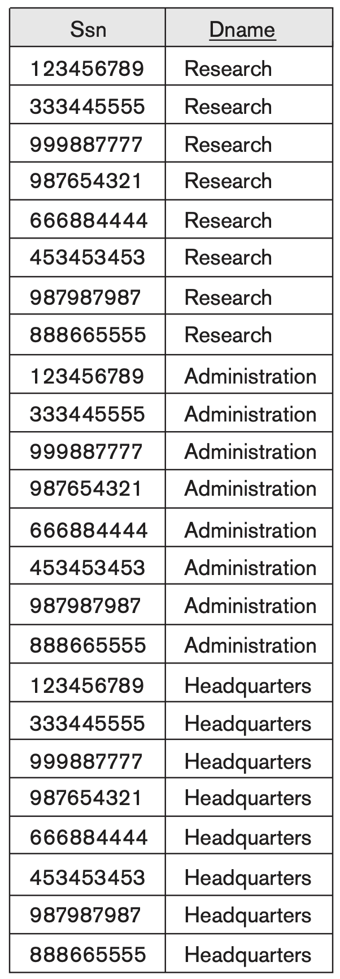
Employee X Department

Slide 45
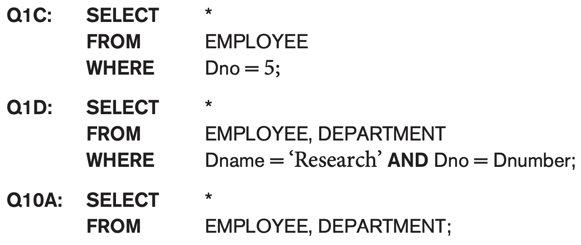
Unspecified WHERE Clause and Use of the Asterisk (cont’d.)
Specify an asterisk (*)
Retrieve all the attribute values of the selected tuples
The * can be prefixed by the relation name; e.g., EMPLOYEE * (all attributes of EMPLOYEE)

Slide 46
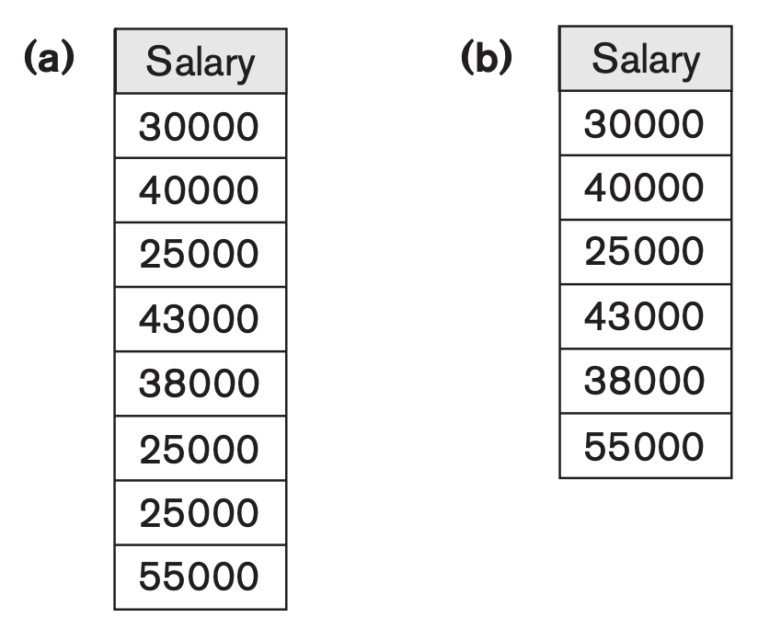
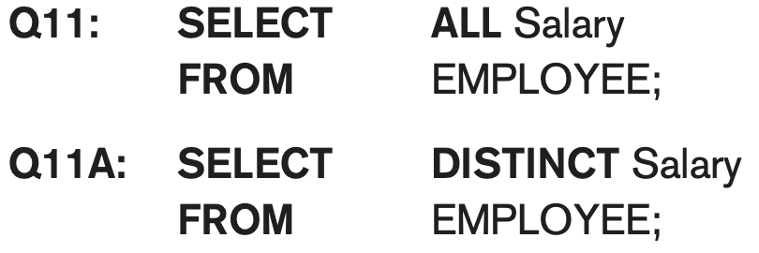
Tables as Sets in SQL
SQL does not automatically eliminate duplicate tuples in query results
For aggregate operations (See sec 7.1.7) duplicates must be accounted for
Use the keyword DISTINCT in the SELECT clause
Only distinct tuples should remain in the result

Slide 47
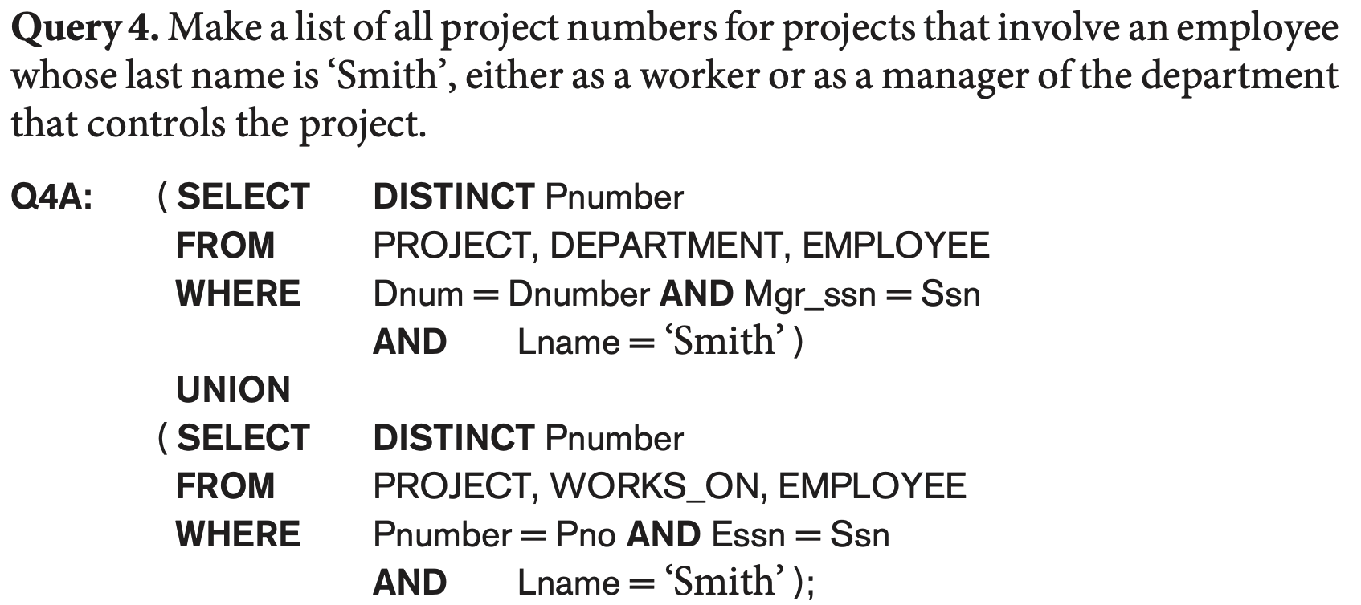
Tables as Sets in SQL (cont’d.)
Set operations
UNION, EXCEPT (difference), INTERSECT
Type compatibility is needed for these operations to be valid

Slide 48
UNION, EXCEPT (difference), INTERSECT
There are set union (UNION), set difference (EXCEPT), and set intersection (INTERSECT) operations.
The relations resulting from these set operations are sets of tuples; that is, duplicate tuples are eliminated from the result
Type Compatibility: Make sure that the two relations on which we apply the operation have the same attributes and that the attributes appear in the same order in both relations

Slide 49
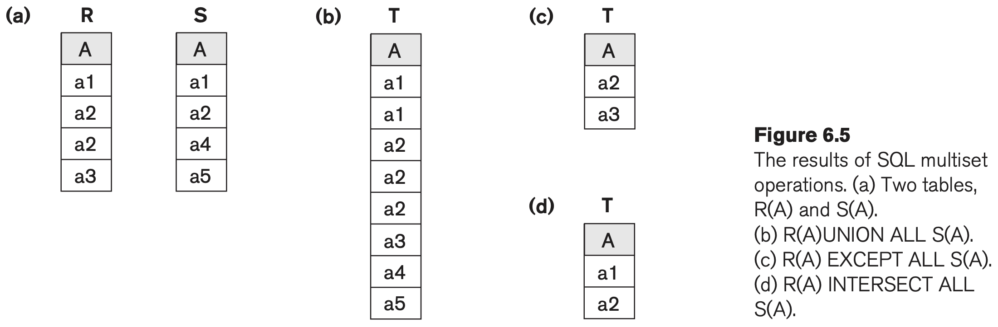
Multiset Operations (ALL)
Corresponding multiset operations: UNION ALL, EXCEPT ALL, INTERSECT ALL)

Slide 50

Substring Pattern Matching and Arithmetic Operators
LIKE comparison operator
Used for string pattern matching
% replaces an arbitrary number of zero or more characters
underscore (_) replaces a single character
Examples: WHERE Address LIKE ‘%Houston,TX%’;
WHERE Ssn LIKE ‘_ _ 1_ _ 8901’;

Slide 51
Substring Pattern Matching and Arithmetic Operators (cont’d.)
If you really (literally) need to use _ or % characters use the escape character
E.g., ‘AB\_CD\%EF’ == ‘AB_CD%EF’
Also, we need a rule to specify apostrophes or single quotation marks (‘ ’) if they are to be included in a string because they are used to begin and end strings. If an apostrophe (’) is needed, it is represented as two consecutive apostrophes (”) so that it will not be interpreted as ending the string.

Slide 52
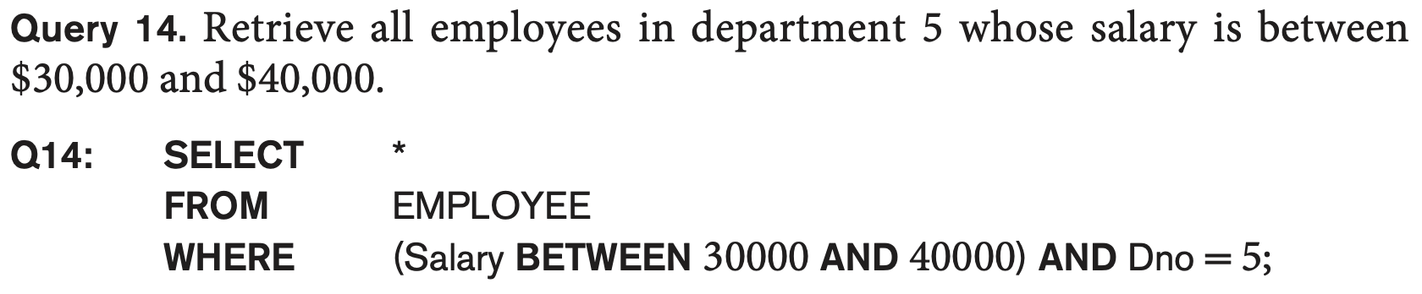
BETWEEN comparison operator

Slide 53
Arithmetic Operations
Standard arithmetic operators:
Addition (+), subtraction (–), multiplication (*), and division (/) may be included as a part of SELECT
Query 13. Show the resulting salaries if every employee working on the ‘ProductX’ project is given a 10 percent raise.
SELECT E.Fname, E.Lname, 1.1 * E.Salary AS Increased_sal
FROM EMPLOYEE AS E, WORKS_ON AS W, PROJECT AS P
WHERE E.Ssn=W.Essn AND W.Pno=P.Pnumber AND P.Pname=‘ProductX’;

Slide 54
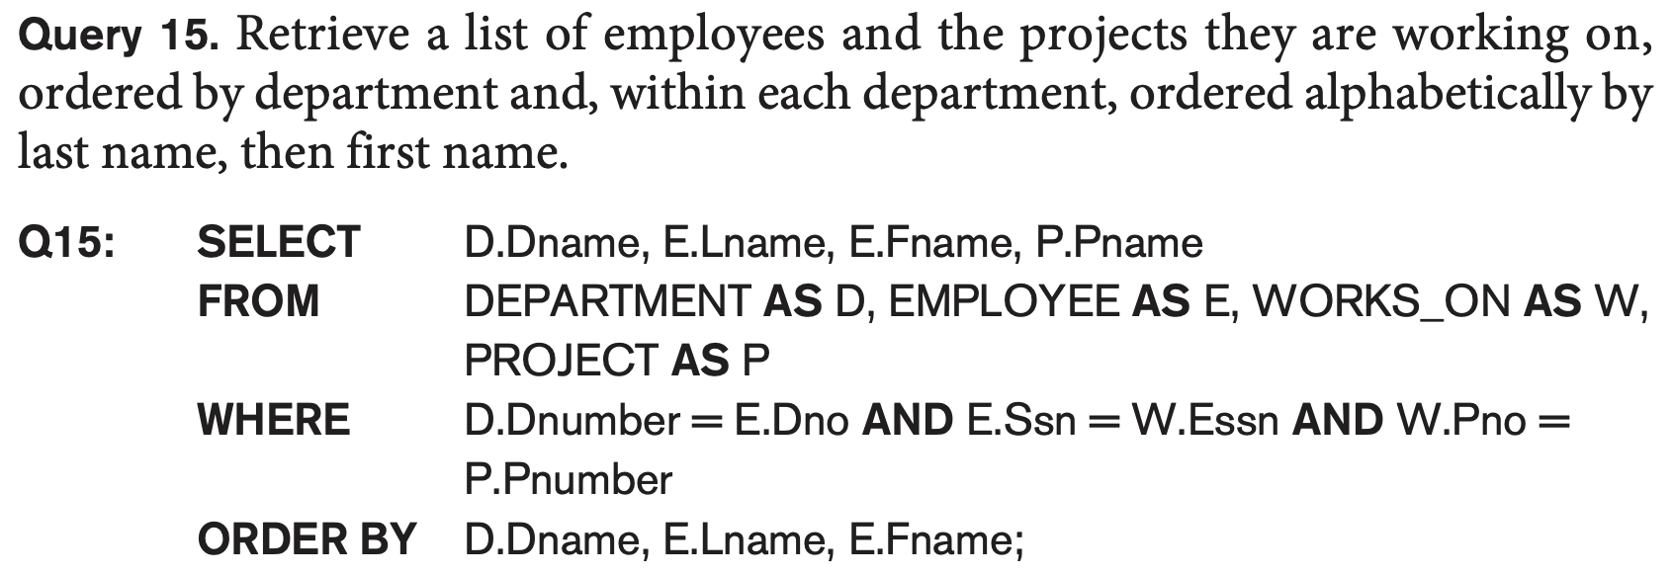
Ordering of Query Results
Use ORDER BY clause
Keyword DESC to see result in a descending order of values
Keyword ASC to specify ascending order explicitly
Typically placed at the end of the query

Slide 55
Ordering of Query Results
ORDER BY D.Dname, E.Lname, E.Fname;
in this query, the resulting tuples are ordered first by D.Dname, then by E.Lname, and finally by E.Fname.
Dname | Lname | Fname | Pname
HR | Brown | Alice | Project X
HR | Brown | Bob | Project Y
IT | Adams | John | Project Z
IT | Clark | Mike | Project A

Slide 56
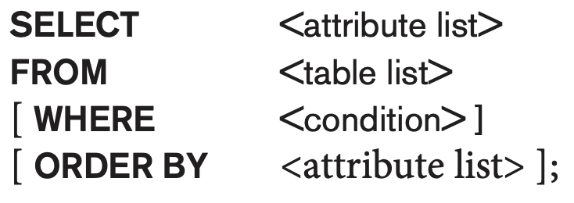
Basic SQL Retrieval Query Block

Slide 57
NULL Values
An important concept is that of NULL values, which are used to represent the values of attributes that may be unknown or may not apply to a tuple.
A special value, called NULL, is used in these cases
In general, we can have several meanings for NULL values, such as value unknown, value exists but is not available, or attribute does not apply to this tuple (also known as value undefined).
Two NULL values are not equal. Especially during queries.

Slide 58
Relational Integrity Constraints
Constraints are conditions that must hold on all valid relation states.
There are three main types of (explicit schema-based) constraints that can be expressed in the relational model:
Key constraints (uniqueness but usually allows null)
Entity integrity constraints (primary keys cannot be null)
Referential integrity constraints
Another schema-based constraint is the domain constraint
Every value in a tuple must be from the domain of its attribute (or it could be null, if allowed for that attribute)

Slide 59
INSERT, DELETE, and UPDATE Statements in SQL
Three commands used to modify the database:
INSERT, DELETE, and UPDATE
INSERT typically inserts a tuple (row) in a relation (table)
UPDATE may update a number of tuples (rows) in a relation (table) that satisfy the condition
DELETE may also update a number of tuples (rows) in a relation (table) that satisfy the condition

Slide 60
INSERT
In its simplest form, it is used to add one or more tuples to a relation
Attribute values should be listed in the same order as the attributes were specified in the CREATE TABLE command
Constraints on data types are observed automatically
Any integrity constraints as a part of the DDL specification are enforced

Slide 61
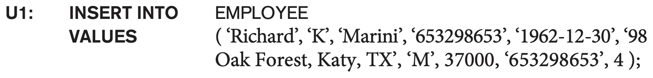
The INSERT Command
Specify the relation name and a list of values for the tuple. All values including nulls are supplied.
specify explicit attribute names
The values must include all attributes with NOT NULL specification and no default value.

Slide 62

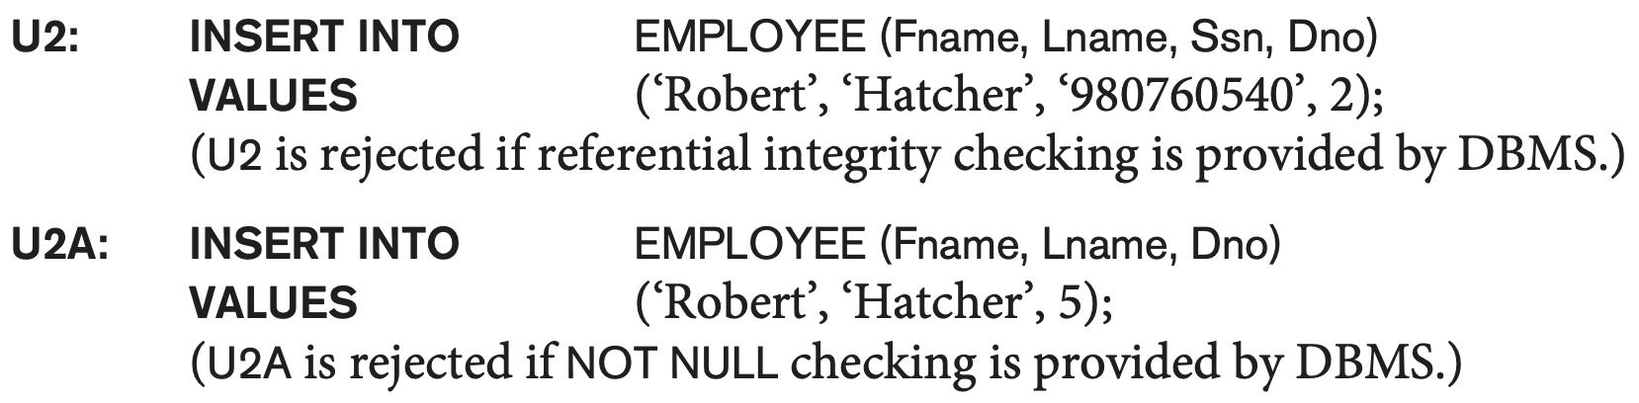
Enforce Integrity Constraints
There is no department no 2
No primary key provided

Slide 63
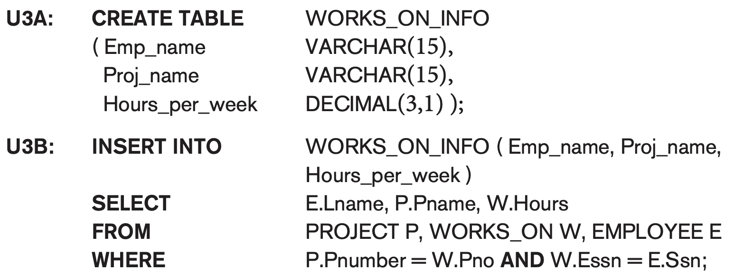
The variation below inserts multiple tuples where a new table is loaded values from the result of a query.

Slide 64
BULK LOADING OF TABLES
Another variation of INSERT is used for bulk-loading of several tuples into tables
A new table TNEW can be created with the same attributes as T and using LIKE and DATA in the syntax, it can be loaded with entire data.
EXAMPLE:
LIKE copies the column definitions (structure) of Students, but not the data. WITH DATA copies the data
CREATE TABLE D5EMPS LIKE EMPLOYEE
(SELECT E.*
FROM EMPLOYEE AS E
WHERE E.Dno=5) WITH DATA;

Slide 65
DELETE
Removes tuples from a relation
Includes a WHERE-clause to select the tuples to be deleted
Referential integrity should be enforced
Tuples are deleted from only one table at a time (unless CASCADE is specified on a referential integrity constraint)
A missing WHERE-clause specifies that all tuples in the relation are to be deleted; the table then becomes an empty table
The number of tuples deleted depends on the number of tuples in the relation that satisfy the WHERE-clause

Slide 66
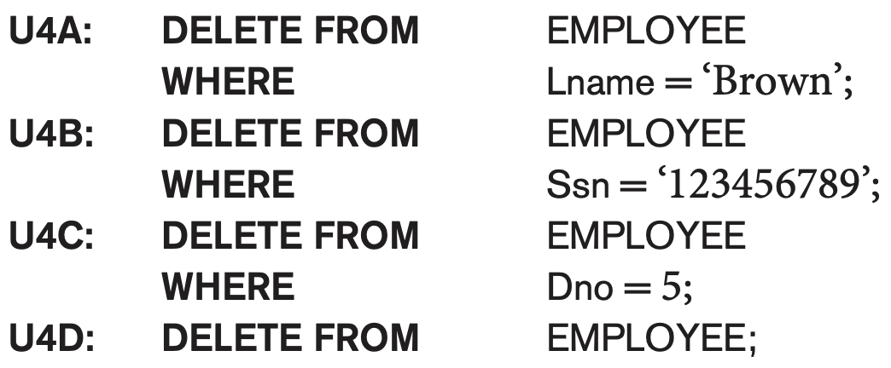
The DELETE Command
Removes tuples from a relation
Includes a WHERE clause to select the tuples to be deleted. The number of tuples deleted will vary.

Slide 67
UPDATE
Used to modify attribute values of one or more selected tuples
A WHERE-clause selects the tuples to be modified
An additional SET-clause specifies the attributes to be modified and their new values
Each command modifies tuples in the same relation
Referential integrity specified as part of DDL specification is enforced

Slide 68
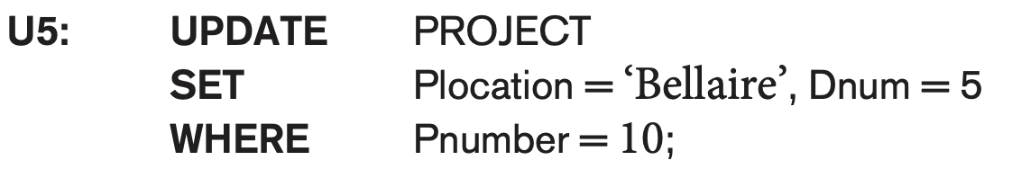
UPDATE (contd.)
Example: Change the location and controlling department number of project number 10 to 'Bellaire' and 5, respectively

Slide 69
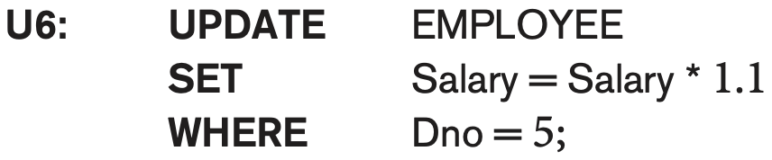
UPDATE (contd.)
Example: Give all employees in the 'Research' department a 10% raise in salary.
In this request, the modified SALARY value depends on the original SALARY value in each tuple
The reference to the SALARY attribute on the right of = refers to the old SALARY value before modification
The reference to the SALARY attribute on the left of = refers to the new SALARY value after modification

Slide 70
Additional Features of SQL
Techniques for specifying complex retrieval queries (see Ch.7)
Writing programs in various programming languages that include SQL statements: Embedded and dynamic SQL, SQL/CLI (Call Level Interface) and its predecessor ODBC, SQL/PSM (Persistent Stored Module) (See Ch.10)
Set of commands for specifying physical database design parameters, file structures for relations, and access paths, e.g., CREATE INDEX

Slide 71
Additional Features of SQL (cont’d.)
Transaction control commands (Ch.20)
Specifying the granting and revoking of privileges to users (Ch.30)
Constructs for creating triggers (Ch.26)
Enhanced relational systems known as object-relational define relations as classes. Abstract data types (called User Defined Types- UDTs) are supported with CREATE TYPE
New technologies such as XML (Ch.13) and OLAP (Ch.29) are added to versions of SQL

Slide 72
Summary
SQL
A Comprehensive language for relational database management
Data definition, queries, updates, constraint specification, and view definition
Covered :
Data definition commands for creating tables
Commands for constraint specification
Simple retrieval queries
Database update commands

